Slide 1
Instruction To The Integrated Data Taking Labview Program
Zhenzhong Shi
12/2013

Slide 2
Overview
The program is designed to integrate the functions of instruments control and data acquisition.
Controlling Instruments:
Temperature (ITC503, LS360).
Magnetic Field (IPS120).
DC outputs from Keithley 6221.
AC outputs from Lock-in SR 7265.
Measuring Instruments:
Temperature (ITC503, LS360).
Magnetic field (IPS120).
Keithley 6221/2182A.
Lock-in SR 7265.
HP DMM 34401A.
HP 3456/7 A, HP 3478A and HP3325FG.
Other instruments with GPIB interfaces.

Slide 3
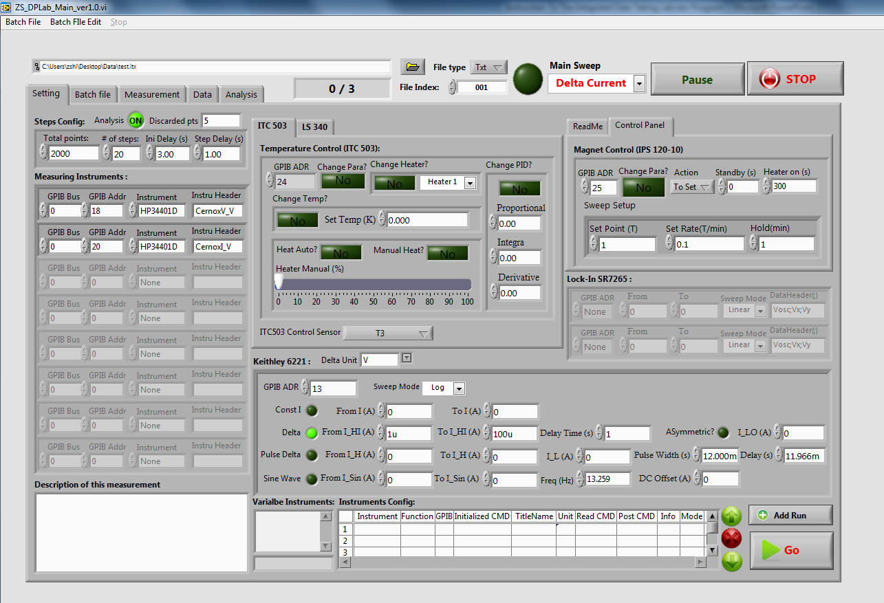
Press “STOP” will
cause the program to
skip the current run,
but acquired data will
still be saved.
Data Files can be chosen
to save as txt, Igor, or both.
Data taking
indicating light
Choose the
sweeping parameter
Batch File Edit Menu
File Saving Address
Choose the tab name to display corresponding page.
Current run/Total runs
File Index that will be appended to the file name.
Main Configuration Panel
After configuring one run,
click “Add Run” to add it
to the “Batch file”.
Click “Go” to start taking data.

Slide 4

Total points: Total number of data points that will be taken in this particular run.
# of steps: How many steps in one particular run. (20 steps will result in 20 data points in the final analysis result. And each data points is an average of 2000/20 = 100 points.)
Ini Delay (s): After setting up the temperature, magnetic field, and other instruments, wait for this much time before taking real data (For stabilization).
Step Delay (s): Data sampling rate. Note the real sampling rate could be affected by the computer speed, and likely to be slower than this.
Analysis: This will turn on the analysis function of the program. The results after analysis will be shown in the “Analysis” page, and will also be saved as summary files in designated file type.
Discarded pts: When performing analysis, discarded these many data points both in the front and end.

Slide 5
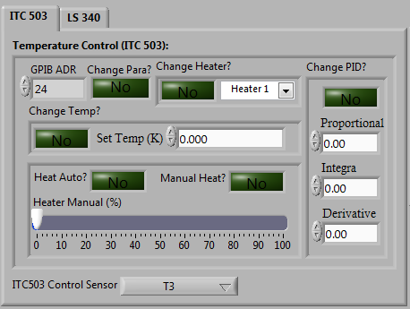
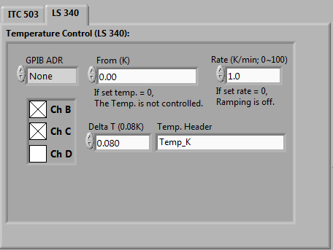
ITC 503
Change Para?: If “yes”, parameter can be changed. If “no”, the temperature will only be recorded for T2 and T3.
LS340
If Target T is set to be 0, T will not be controlled but only monitored.
Select this if changing any parameter of ITC 503.
Target temperature. If equal to 0, T is not controlled.
Specify
temperature change rate
For both ITC503 and LS340, specify the tolerance for temperature fluctuation. When initializing the temperature, the program will monitor T till T is within T_{target} +/- Delta T for 2 min before moving on to taking real data.
Specify which channel is to be used.
For ITC503, specify which sensor is controlled by the heater

Slide 6
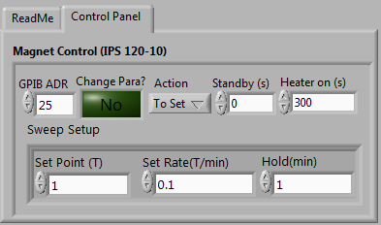
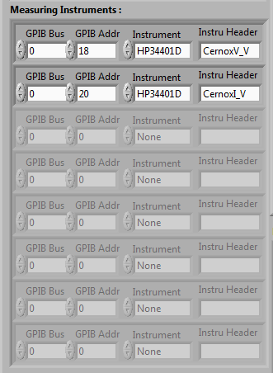
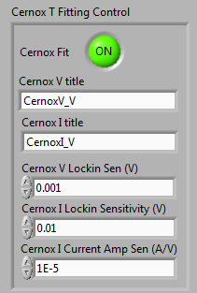
If B is to be controlled, the program will monitor and wait for
B to meet B_{target}, before moving on to taking real data.
Be cautious when setting up multiple runs. Make sure you
have enough LHe to finish the measurements.
When using HP 34401DMM to monitor the Cernox sensor in Heliox, the temperature can be automatically obtained if “Cernox Fit” is “on”. The fit is based on the Chebyshev algorithm, as Xiaoyan’s Mathematica program.
This “Cernox T Fitting Control” panel is located on the “Analysis” page.
“Cernox V title” and “Cernox I title” need to be the same as the “Instru Header” in the “Measuring instruments”

Slide 7
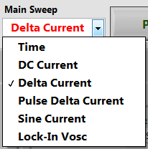


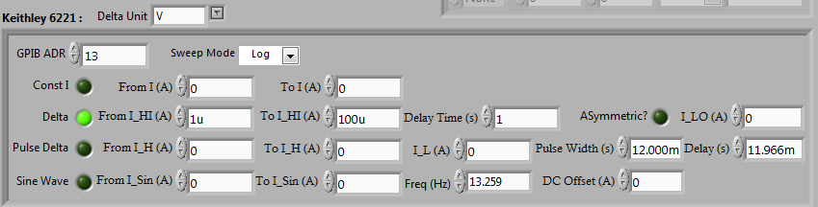
If any particular operating mode is chosen from the “Main Sweep”, the corresponding operating mode needs to be selected from the “Keithley 6221” panel too.
If Keithley 6221 is used, one and only one of the four functions can be selected.
For Delta mode and pulse delta mode, different units can be chosen.
When IV measurement is performed, different sweep mode can be chosen.

Slide 8

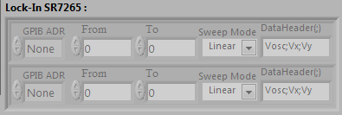
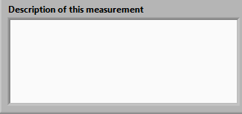
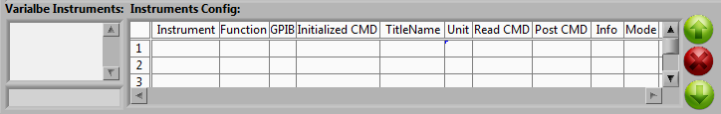
If a lock-in output is to be sweeped, the “Main Sweep” needs to be “Lock-In Vosc”.
If SR7265 is only used to read, set “From” to 0.
If a new instrument is to be used for measurement, it can be configured here, and the reading will be recorded in the data file.
Any comments of the measurement can be typed here. The information will be saved in a header information txt file.
These are used to choose different instruments, or delete any instruments.

Slide 9
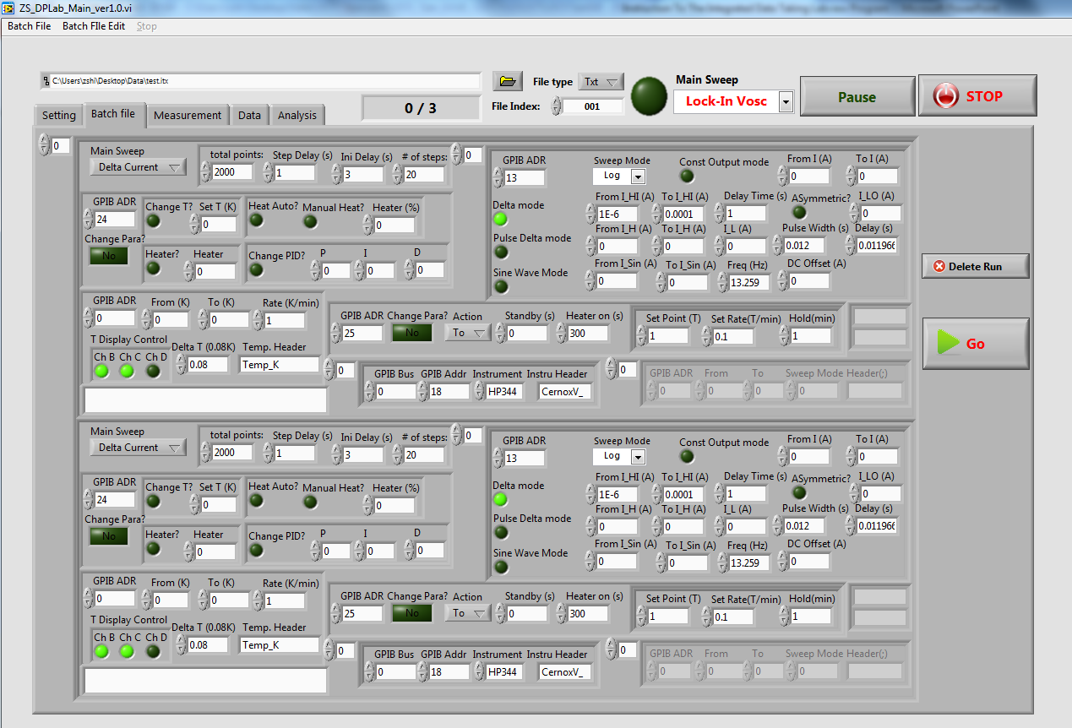
Batch File Page
These are the runs that are configured and added using the “setting” page. The settings here
repeat the ones on “setting” page.

Slide 10


The run batch files can be saved, loaded or edited using the menu and the “Delete Run” button here.
This is the same as the “Go” button on the “Setting” page. Pressing it starts the program.
Certain parameters on the “Setting” page does not appear here, such as “Analysis on”, “discarded pts”, “ITC control Sensor”, etc… These parameters are treated as the same for all the run batch files, and can not be changed from run to run.

Slide 11
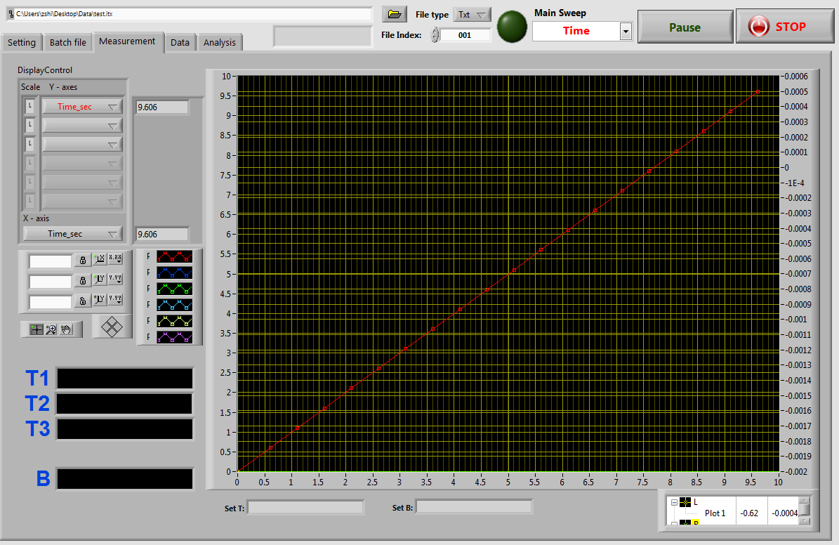
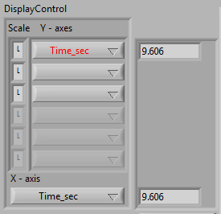
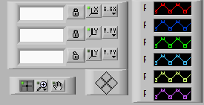
Measurement Page
The current T and B are monitored and the target T and B are displayed at the bottom.
Choose Y axis and X axis for the plot.
For Y axis, multiple variable can be chosen to appear on the same plot.
For Y axis, the Left or Right axis can be chosen for different variables by clicking “L” or “R”. The default value is “L”.
Corresponding data appears for each variable in the box after the variable name.
With this panel
Different color can be chosen for different variables.
The plot can be plotted in linear or log mode.
The plot can be zoomed.
etc…

Slide 12
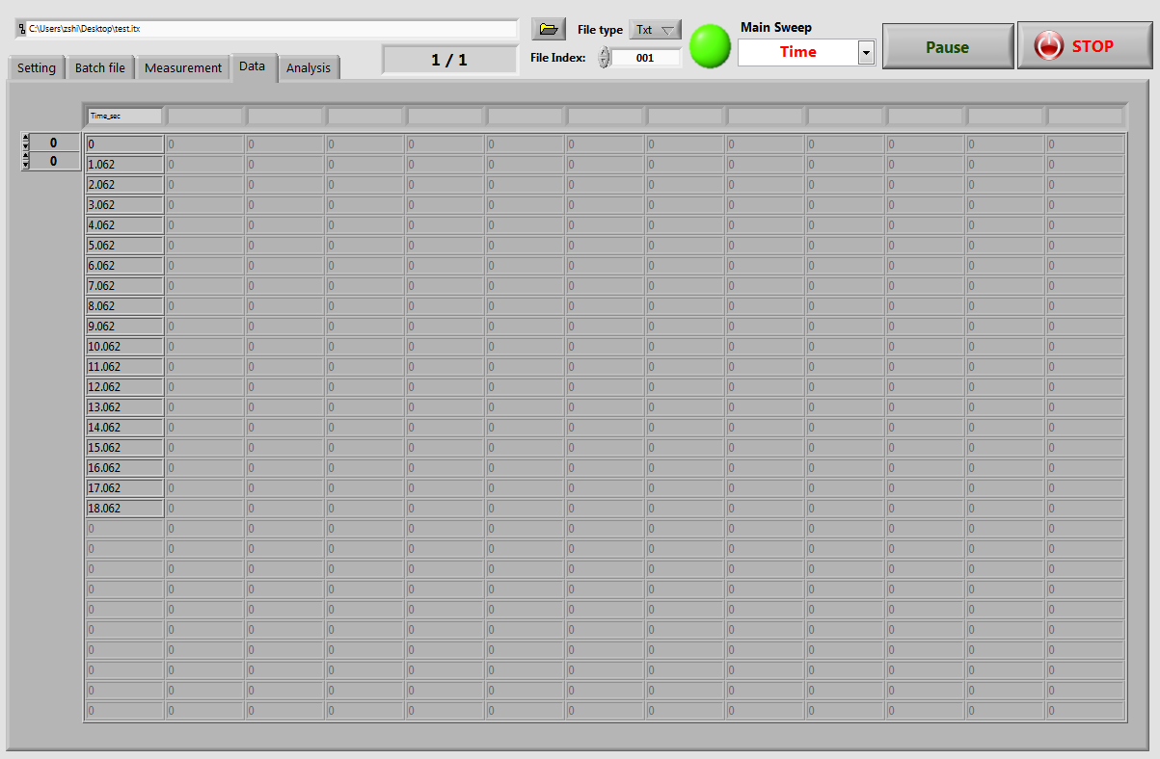
Data Table Page
All the data is displayed here.

Slide 13
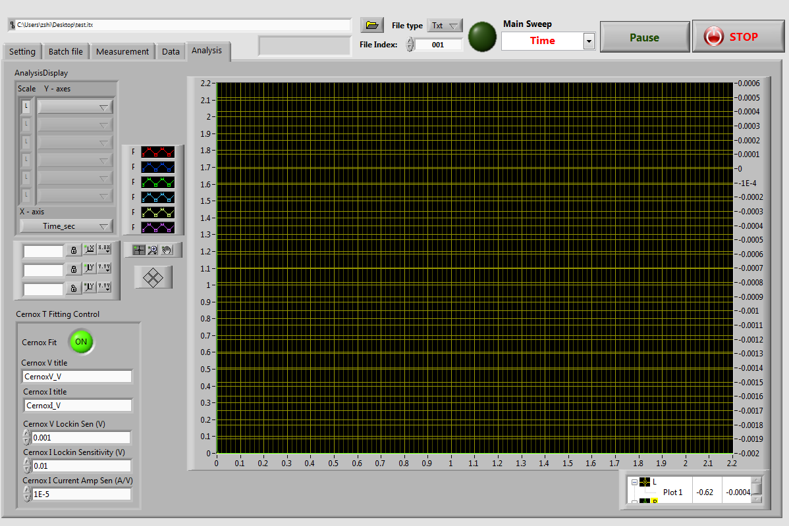
Analysis Page
When “Analysis on” on the “Setting” page is chosen, the program calculates the average of all the measured data for each step. And the results after analysis can be displayed here.

Slide 14
Examples In Real Measurements

Slide 15
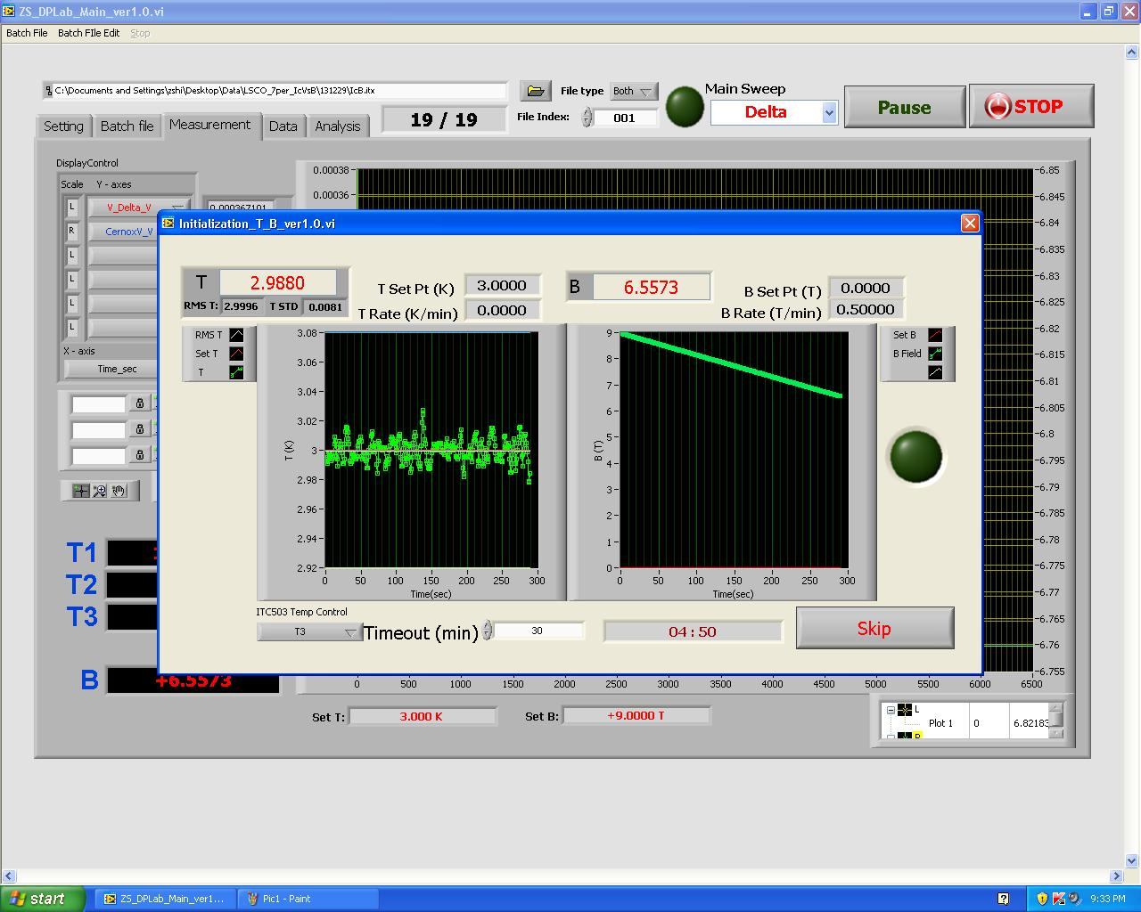

Slide 16
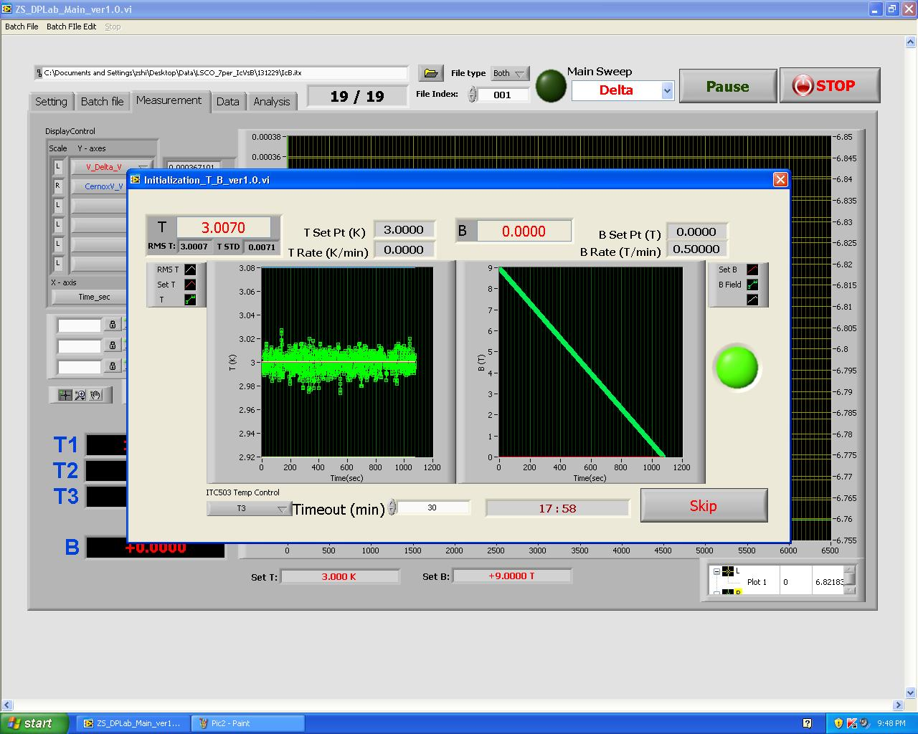
When both T and B reaches target, this indicator turns on.

Slide 17
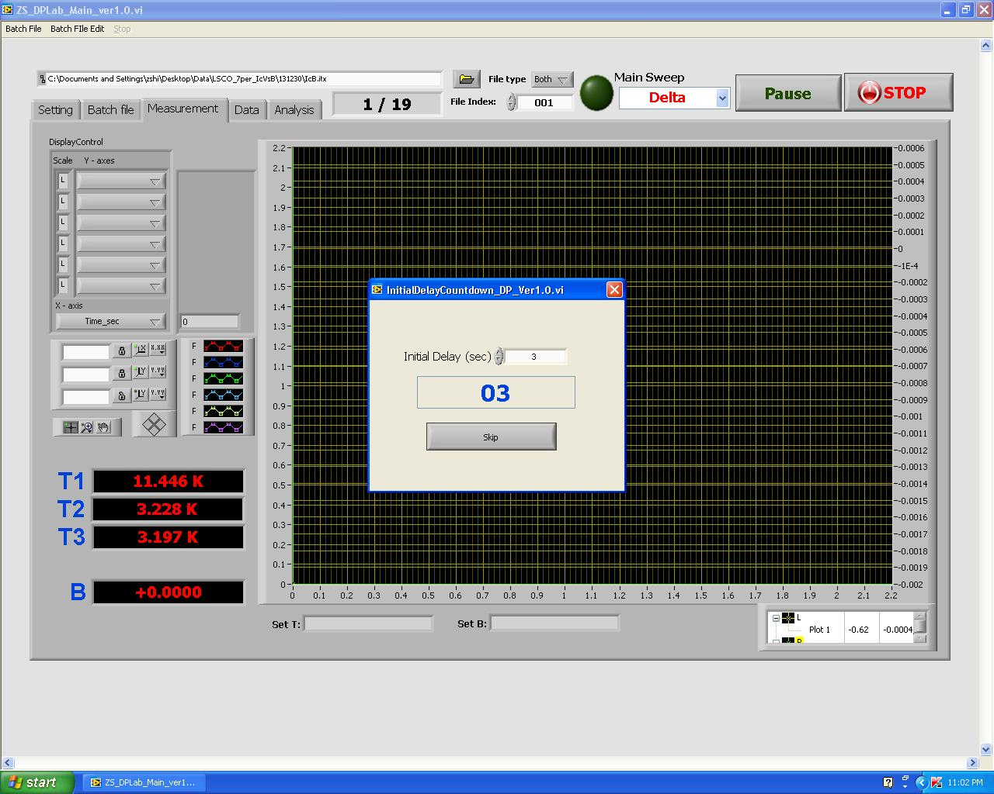

Slide 18
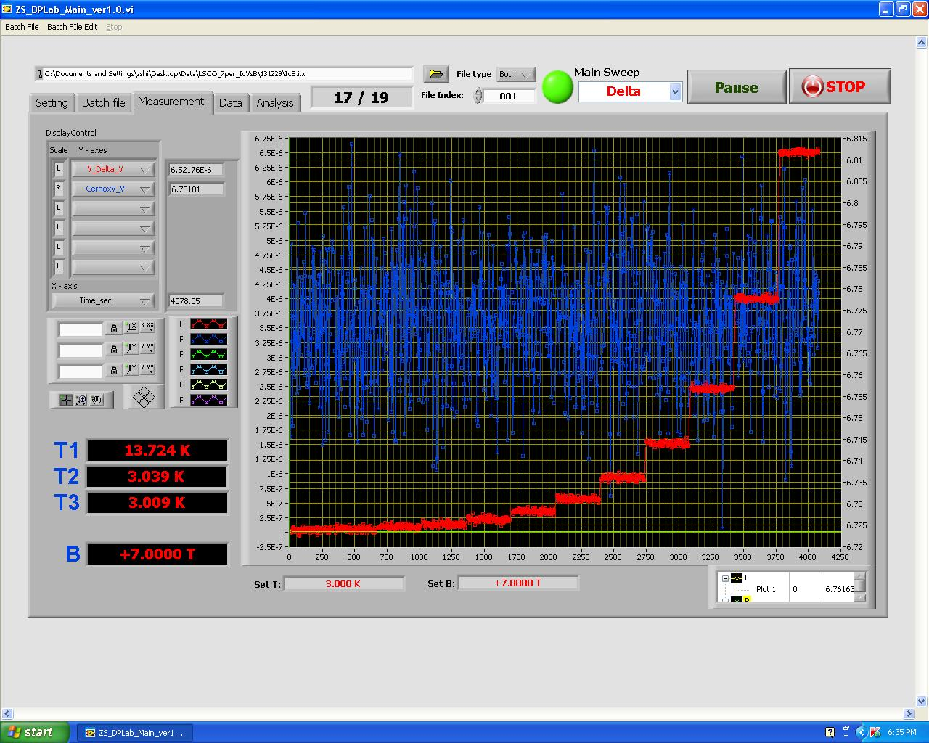

Slide 19
